Slide 1



Lesson 9: JS (Part 3)
<Web />
Front-end
Development
University of Tehran
Lecturer:
Misagh Mohaghegh
ACM
Summer of Code 2024

Slide 2
A Short Review…
Strings, length, and concatenation
Template strings (multi-line, interpolation)
Substring, slice, and toUpperCase
Trim, padding, and repeat
Search, replace, and split
Number, BigInt safe rage, NaN and Infinity
Number toString and from string
Array and looping methods (for i, for x of arr, forEach)
Push, pop, unshift, shift, spread operator
Array toString and join, splice and isArray
BOM and DOM navigation and manipulation
Events

Slide 3
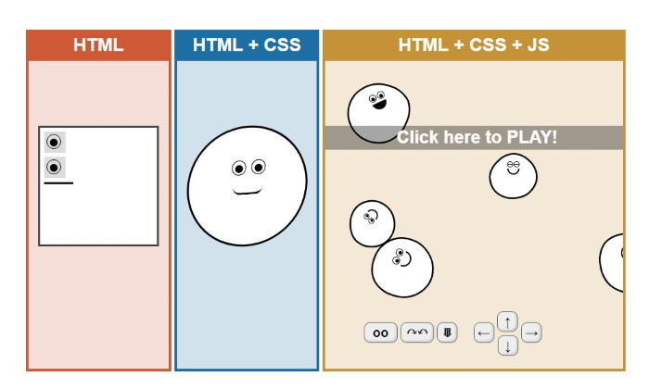
Continue…

Slide 4

JavaScript

Slide 5
Local Storage

Slide 6
Storages
There are many storages in JavaScript that can be used to store data in the browser:
Cache Storage (used for caching)
Cookies (key-value pairs that are sent to the server on each request)
Indexed DB (a local NoSQL database)
Local Storage (a key-value storage)
Session Storage (a local storage that expires when the tab is closed)

Slide 7
Web Storage API
The Web Storage API provides 2 mechanisms to store key-value pairs in the browser:
Local Storage
Session Storage
The local storage can be accessed via the window.localStorage object.
The session storage is accessed via the window.sessionStorage object.
They both return a Storage object instance and have the same methods, but are different storages.
Local storage persists even when the browser is closed.
Session storage is limited to when the tab is open (including reloads).
The maximum size of each Storage is 5MB.

Slide 8
Local Storage
Each origin will have its own local storage.
The methods to use the Storage are as follows:
localStorage.setItem("name", "Misagh");
localStorage.getItem("name");
localStorage.removeItem("name"); localStorage.clear();
localStorage.length;

Slide 9
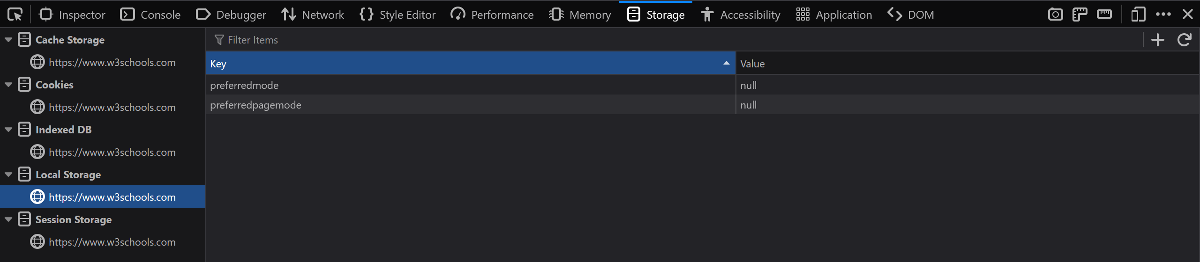
Storage in Dev Tools
We can check the contents of the storages using the browser dev tools (inspect):

Slide 10
Object

Slide 11
Objects
We have already seen how we can define and use objects in JavaScript:
const person = {
firstName: "Misagh",
lastName: "Mohaghegh",
age: 22,
fullName: function() {
return this.firstName + " " + this.lastName;
}
};
console.log(person.age, person.fullName(), person["firstName"])

Slide 12
Object Properties
We use the 'this' keyword to access the object inside a function.
Object properties are all fields of an object (firstName, ...).
Object methods are just functions stored in properties (fullName).
const person = { name: "Misagh" };
person.country = "Iran"; // adding a new property
delete person.country; // removing a property
const copy = person; // this does not copy
copy.name = "test";
person.name == "test";

Slide 13
Nested Objects
Objects can be nested:
const person = {
name: "feliks",
wife: { name: "kate" },
kids: [
{ name: "alex" },
{ name: "akane" }
]
};
console.log(person.wife.name, person["wife"]["name"], person.kids[0].name);

Slide 14
Methods
There are 2 ways to define methods in an object:
const person = {
name: "feliks",
greet: function() { return "I am " + this.name; },
greet: () => "I am " + this.name,
introduce() { return "I am " + this.name; },
};

Slide 15
Looping
We can loop over all object properties:
for (let k in person) {
console.log(`Key: ${k} - Value: ${person[k]}`);
}
for (let v of Object.values(person)) { // there is also Object.keys(person)
console.log("Value:", v);
}
for (let [k, v] of Object.entries(person)) {
console.log(k, v);
}

Slide 16
Accessors (Getter and Setter)
Accessors or computed properties can be defined.
These allow us to execute some logic for getting and setting a field.
const person = {
name: "feliks",
language: "en",
get lang() { return this.language; },
set lang(newLang) { this.language = newLang; }
};
person.lang == "en"
person.lang = "fa";

Slide 17
Accessors vs Functions
The example below demonstrates the difference:
const person = {
name: "feliks",
get about() { return "I am: " + this.name; },
about2: function() { return "I am: " + this.name; }
};
console.log(person.about, person.about2())

Slide 18
Object Constructor Function
Sometimes we need to create objects of the same type which have the same properties.
We can use constructor functions for that. They usually start with uppercase letter.
The 'new' keyword is used to create an object from a constructor.
function Person(name, age) {
this.name = name;
this.age = age;
}
// create Person object instances:
const me = new Person("Misagh", 22);
const you = new Person("Kyle", 24);

Slide 19
New Object Properties
After creating new objects, they are no longer related and changing or adding or deleting properties from one instance does not affect the other instances:
function Person(name, age) {
this.name = name;
this.age = age;
}
const me = new Person("Misagh", 22);
const you = new Person("Kyle", 24);
me.hairColor = "blue";
you.hairColor == undefined

Slide 20
Adding New Properties
When adding new properties to an object instance, the other instances won't have it.
To do that, we must add the property to the object constructor prototype:
function Person(name) { this.name = name; }
const a = new Person("test");
a.newProperty = 12; // other instances don't have this
Person.newProperty = 12; // does not work
Person.prototype.newProperty = 12;
Person.prototype.introduce = function() { return "I am " + this.name; };
a.introduce();

Slide 21
Instance of
To check if an object type variable is created from an object constructor, we use the 'instanceof' keyword:
const a = new Person("name");
typeof a == 'object'
if (a instanceof Person) {
console.log("Yes");
}
a instanceof Object == true

Slide 22
Built-in Object Constructors
There are many built-in object constructors but some of them shouldn't be used:
new Object() // use {}
new Array() // use []
new RegExp() // use /regex/
new Function() // use () => {}
new Map()
new Set()
new Date()
// "", 0, false are primitive types and not object types

Slide 23
Built-in Primitive Constructors
The JS primitive types also have a corresponding object constructor.
They should not be used to just get a primitive value.
const a = new Number(10);
const b = Number(10);
typeof a == 'object'
typeof b == 'number'
a instanceof Number; // true
b instanceof Number; // false

Slide 24
Prototype
All objects have a prototype chain. Whenever we access a property, first the actual object properties are searched. If it is not found, the prototype object's properties are searched.
function Person(name) {
this.name = name;
this.greet = () => "Hi!";
}
// this will create the greet method every time we make an instance of Person
const a = new Person("a");
const b = new Person("b");
// they both have their own greet method which does the same thing
// we can factor the method out into the Person prototype

Slide 25
Prototype
To add a method to the object prototype:
function Person(name) {
this.name = name;
}
Person.prototype.greet = () => "Hi!";
const a = new Person("a");
a.greet();
Object.getPrototypeOf(a) // Person.prototype { greet: ... }

Slide 26
Prototype
Setting the entire prototype object:
const personPrototype = {
greet: function() { return "Hi!"; }
}
function Person(name) {
this.name = name;
}
Object.assign(Person.prototype, personPrototype);
const a = new Person("a");
a.greet();

Slide 27
Own Property
We can use the Object.hasOwn method to see if a property is for the object constructor:
function Person(name) {
this.name = name;
}
Person.prototype.greet = () => "Hi!";
const a = new Person("a");
Object.hasOwn(a, "name") // true
Object.hasOwn(a, "greet") // false

Slide 28
Own Property
The for … in loop iterates the prototype as well.
function Person(name) {
this.name = name;
}
Person.prototype.greet = () => "Hi!";
const a = new Person("a");
for (let x in a) { console.log(x); } // name, greet
for (let x of Object.keys(a)) { console.log(x); } // name

Slide 29
Class

Slide 30
Classes
Classes were introduced in ES6.
They are templates for easier creation of object constructors and prototype inheritance.
class Person {
constructor(name) {
this.name = name;
}
}
const a = new Person("a");

Slide 31
Methods
Classes can easily contain methods:
class Person {
constructor(name) {
this.name = name;
}
age() { return 22; }
}
const a = new Person("a");
console.log(a.age());

Slide 32
Accessors (Getters and Setters)
Accessors can be placed in a class just like objects:
class Person {
constructor(name) {
this.name = name;
this._age = 22;
}
get age() { return this._age + 1; }
}
const a = new Person("a");
console.log(a.age);

Slide 33
Inheritance
Inheritance is easy with classes:
class Person {
constructor(name) { this.name = name; }
greet() { return "Hi!"; }
}
class Teacher extends Person {
constructor(name, course) {
super(name);
this.course = course;
}
}
const a = new Teacher("Misagh", "Frontend");

Slide 34
Static Methods
Static methods are methods that are defined on the class itself.
They cannot be accessed via a class instance.
class Person {
constructor(name) { this.name = name; }
static greet() { return "Hi!"; }
}
const a = new Person("a");
a.greet() // error
Person.greet()

Slide 35
Static Fields
Static fields are similar to static methods:
class Person {
static test = "Hi!";
constructor(name) { this.name = name; }
}
const a = new Person("a");
a.test // undefined
Person.test

Slide 36
Use Strict

Slide 37
"use strict"
The "use strict" directive was added in ES5.
It is a string literal and is ignored by older versions.
When strict mode is enabled, more errors are caught.
"use strict";
x = 12; // error, x is not declared
const obj = {
get field() { return 10; }
}
obj.field = 12; // error, writing to read-only property

Slide 38
Thank you for your attention.

